Slide 1
Module-5
Network Management Applications

Slide 2
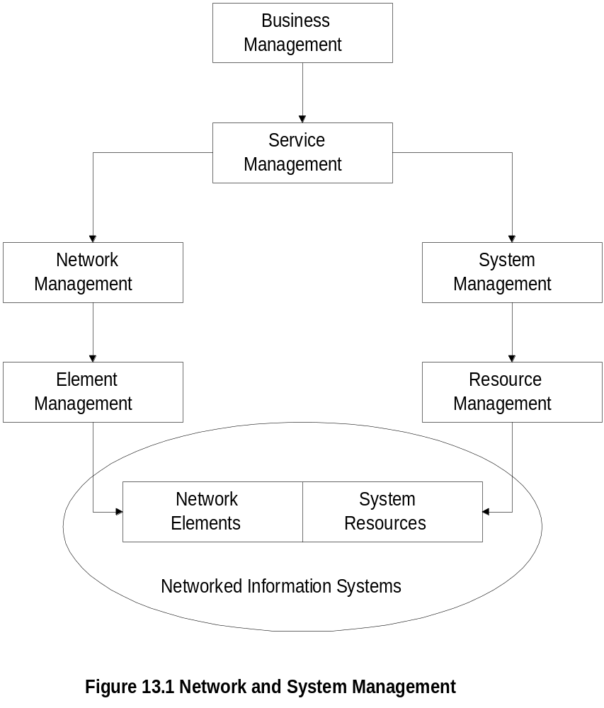
Network and Systems Mgmt
  Notes
TMN architecture expanded to include systems
management

Slide 3
Management Applications
OSI Model
  Configuration
  Fault
  Performance
  Security
  Accounting
Reports
Service Level Management
Policy-based management
  Notes

Slide 4
Configuration Management
Network Provisioning
Inventory Management
  Equipment
  Facilities
Network Topology
Database Considerations
  Notes

Slide 5
Circuit Provisioning
Network Provisioning
  Provisioning of network resources
    Design
    Installation and maintenance
  Circuit-switched network
  Packet-switched network, configuration for
    Protocol
    Performance
    QoS
  ATM networks
  Notes
Examples:
  TIRKS (Trunk Integrated Record Keeping
  System) for circuit-switched networks
  E1 in TIRKS for equipment management
  F1 in TIRKS for facilities management

Slide 6
Network Topology
Manual
Auto-discovery by NMS using
  Broadcast ping
  ARP table in devices
Mapping of network
  Layout
  Layering
Views
  Physical
  Logical
  Notes

Slide 7
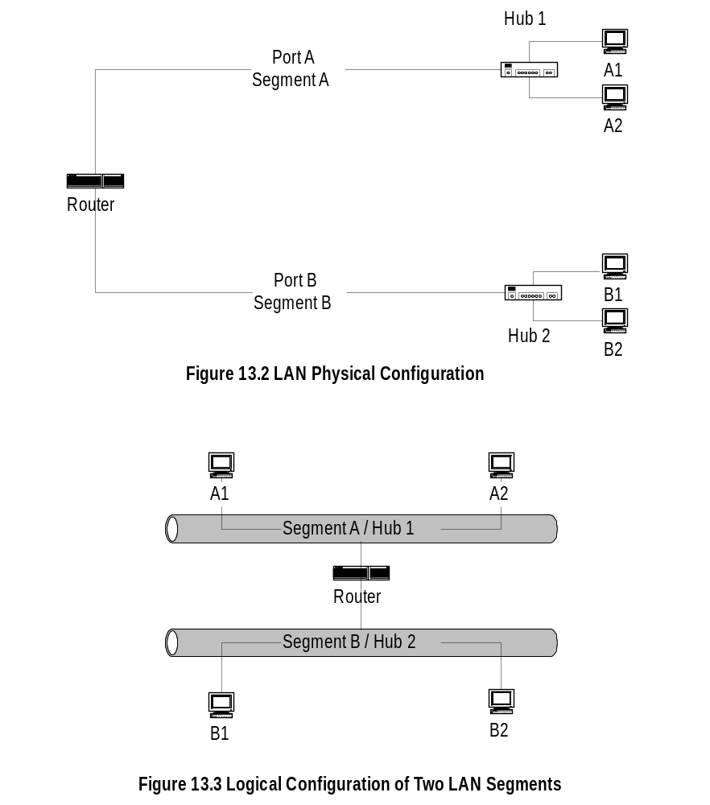
Traditional LAN Configuration
  Notes
One-to-one mapping between physical and logical
configuration

Slide 8
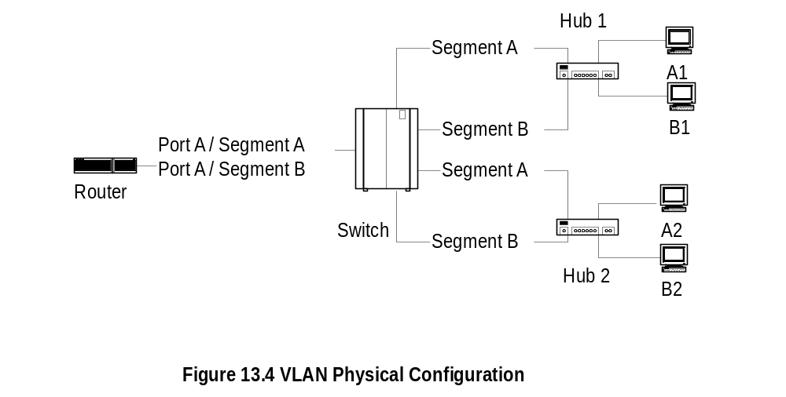
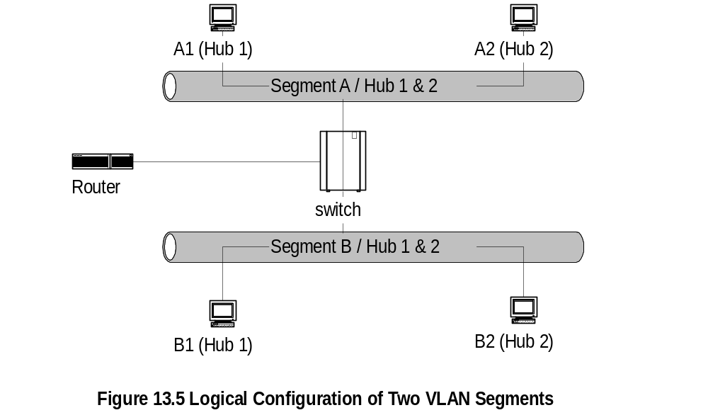
Virtual LAN Configuration
  Notes
Physical and logical configurations different
Physical location obtained from System group

Slide 9
Fault Management
Fault is a failure of a network component
Results in loss of connectivity
Fault management involves:
  Fault detection
    Polling
    Traps: linkDown, egpNeighborLoss
  Fault location
    Detect all components failed and trace
    down the tree topology to the source
    Fault isolation by network and SNMP tools
    Use artificial intelligence /
    correlation techniques
  Restoration of service
  Identification of root cause of the problem
  Problem resolution
  Notes

Slide 10
Performance Management
Tools
Performance Metrics
Data Monitoring
Problem Isolation
Performance Statistics
  Notes
Tools:
  Protocol analyzers
  RMON
  MRTG

Slide 11
Performance Metrics
Macro-level
    Throughput
    Response time
    Availability
    Reliability
Micro-level
    Bandwidth
    Utilization
    Error rate
    Peak load
    Average load
  Notes

Slide 12
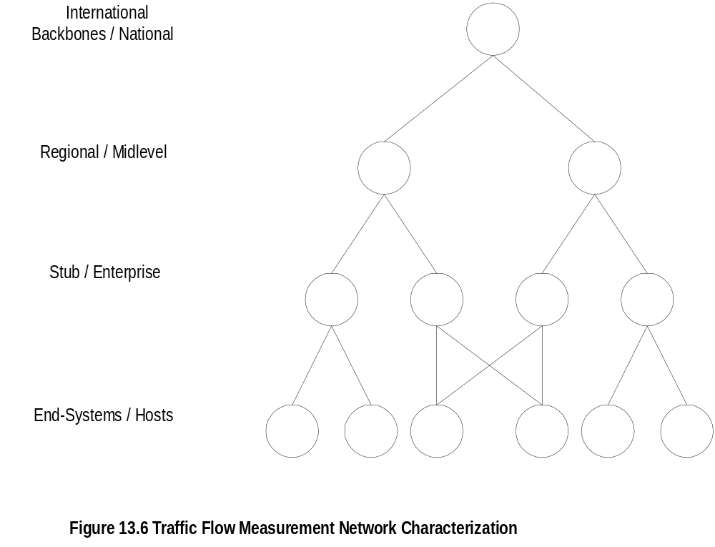
Traffic Flow Measurement
Network Characterization
  Notes
Four levels defined by IETF (RFC 2063)
Three measurement entities:
  Meters gather data and build tables
  Meter readers collect data from meters
  Managers oversee the operation
Meter MIB (RFC 2064)
NetrMet - an implementation(RFC 2123)

Slide 13
Data Monitoring and
Problem Isolation
Data monitoring
  Normal behavior
  Abnormal behavior (e.g., excessive collisions,
  high packet loss, etc)
  Set up traps (e.g., parameters in alarm group
  in RMON on object identifier of interest)
  Set up alarms for criticality
  Manual and automatic clearing of alarms
Problem isolation
  Manual mode using network and SNMP tools
  Problems in multiple components needs
  tracking down the topology
  Automated mode using correlation technology
  Notes

Slide 14
Performance Statistics
Traffic statistics
Error statistics
Used in
  QoS tracking
  Performance tuning
  Validation of SLA
  Trend analysis
  Facility planning
  Functional accounting
  Notes

Slide 15
Event Correlation Techniques
Basic elements
  Detection and filtering of events
  Correlation of observed events using AI
  Localize the source of the problem
  Identify the cause of the problem
Techniques
  Rule-based reasoning
  Model-based reasoning
  Case-based reasoning
  Codebook correlation model
  State transition graph model
  Finite state machine model
  Notes
Correlating events by matching multiple log entries from a single source or multiple sources based on logged values, such as timestamps, IP addresses, and event types

Slide 16
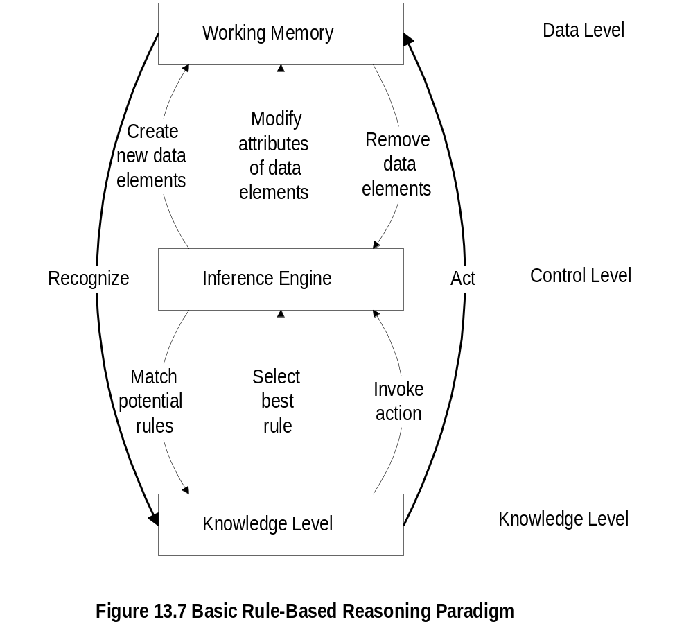
Rule-Based Reasoning
  Notes
Knowledge base contains expert knowledge on
problem symptoms and actions to be taken
if -> then
condition -> action
Working memory contains topological and state
information of the network; recognizes system going into
faulty state
Inference engine in cooperation with knowledge base
decides on the action to be taken
Knowledge executes the action

Slide 17
Rule-Based Reasoning
Rule-based paradigm is an iterative process
RBR is “brittle” if no precedence exists
An exponential growth in knowledge base poses
problem in scalability
Problem with instability
if packet loss < 10% alarm green
if packet loss => 10% < 15% alarm yellow
if packet loss => 15% alarm red
Solution using fuzzy logic
  Notes

Slide 18
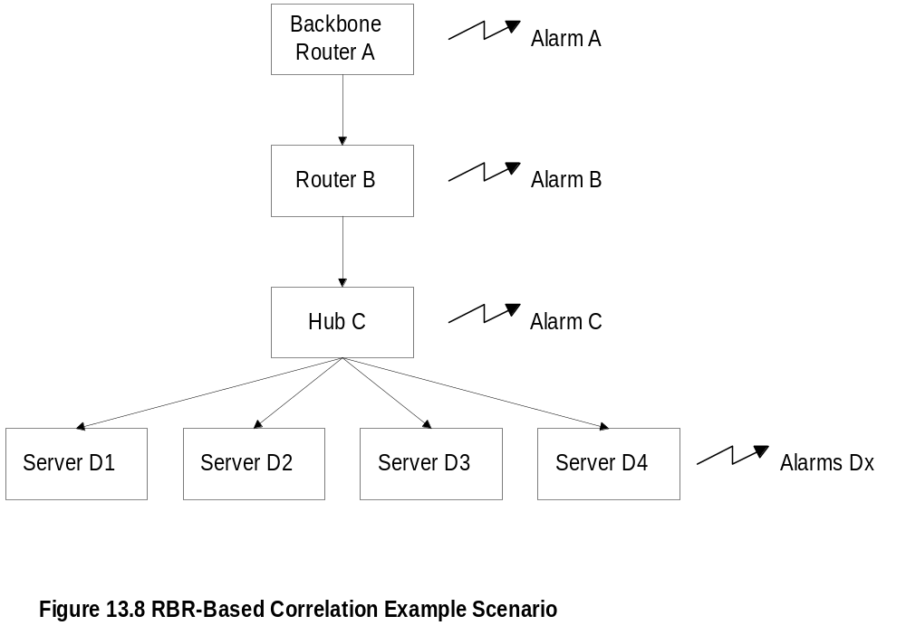
Configuration for RBR Example
  Notes

Slide 19
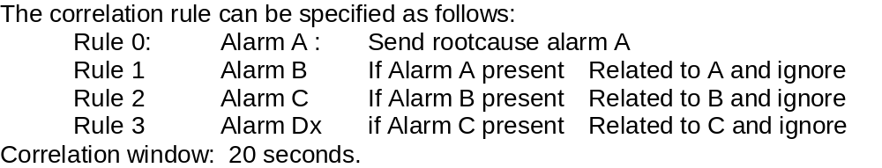
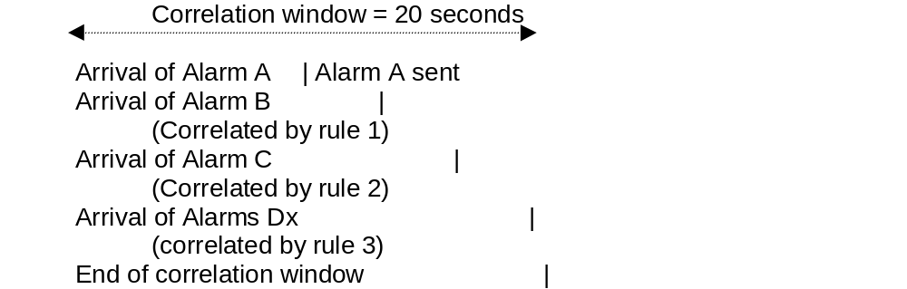
RBR Example
  Notes

Slide 20
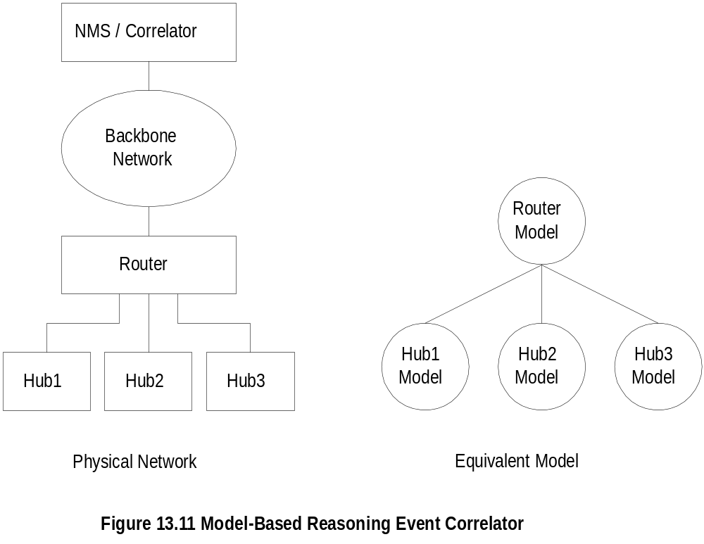
Model-Based Reasoning
  Notes
Object-oriented model
Model is a representation of the component it models
Model has attributes and relations to other models
Relationship between objects reflected in a similar
relationship between models

Slide 21
\
MBR Event Correlator
Example:
Hub 1 fails
Recognized by Hub 1 model
Hub 1 model queries router model
Router model
declares failure
Router model
declares no
failure
Hub 1 model
declares NO failure
Hub 1 model
declares Failure
  Notes
\

Slide 22
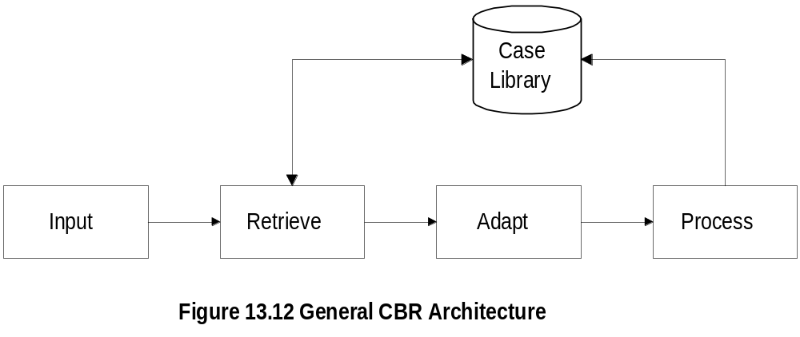
Case-Based Reasoning
  Notes
Unit of knowledge
  RBR rule
  CBR case
CBR based on the case experienced before;
extend to the current situation by adaptation
Three adaptation schemes
  Parameterized adaptation
  Abstraction / re-specialization adaptation
  Critic-based adaptation

Slide 23
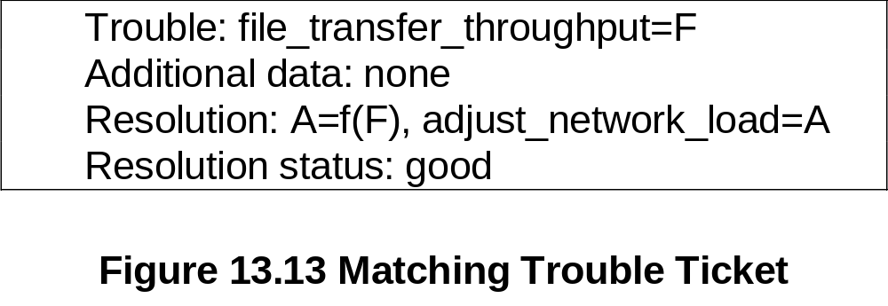
CBR: Matching Trouble Ticket
Example: File transfer throughput problem
  Notes
Trouble ticket in case library: A = f(F)
Parameter A is a function of Parameter F

Slide 24
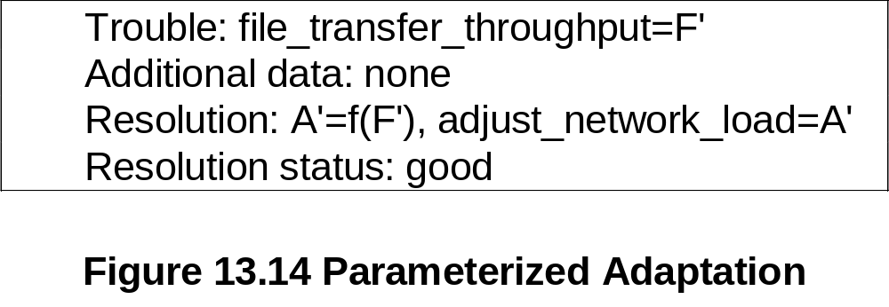
CBR: Parameterized Adaptation
  Notes
A = f(F)
A’ = f(F’)
Functional relationship f(x) remains the same

Slide 25
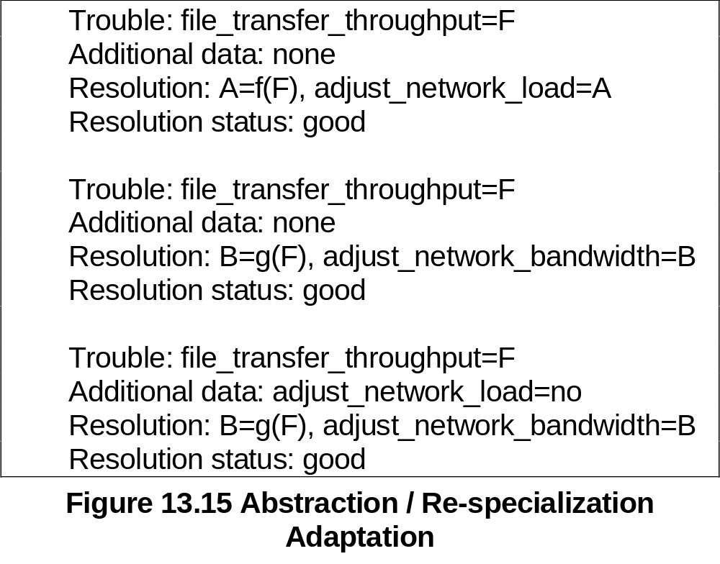
CBR: Abstraction / Re-specialization
  Notes
Two possible resolutions
  A = f(F) Adjust network load level
  B = g(F) Adjust bandwidth
Resolution based on constraint imposed

Slide 26
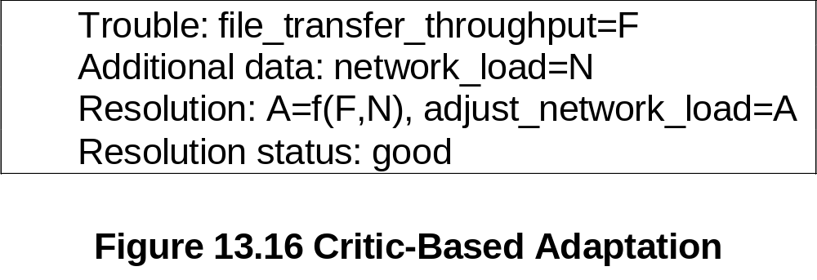
CBR: Critic-Based Adaptation
  Notes
Human expertise introduces a new case
N (network load) is an additional parameter
added to the functional relationship

Slide 27
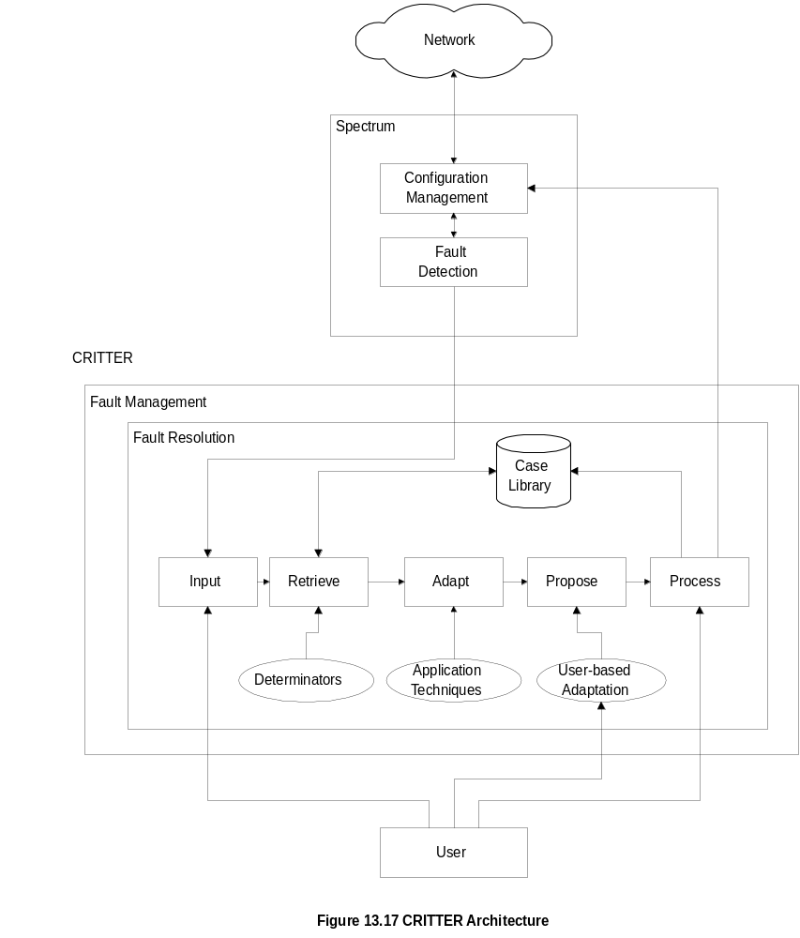
CBR-Based Critter
  Notes
CRITTER is CBR-based trouble resolution system
Integrated with Cabletron Spectrum NMS
“Propose” is additional (5th) module to CBR
architecture; permits manual intervention

Slide 28
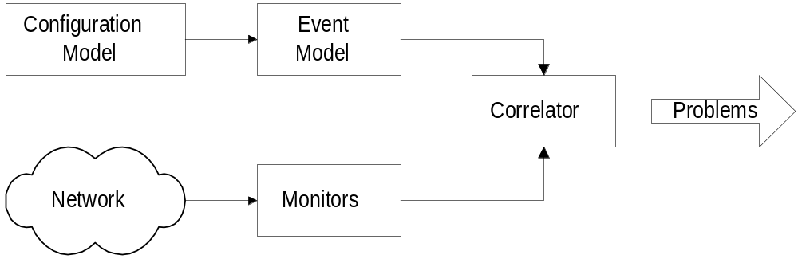
Codebook Correlation Model:
Generic Architecture
  Notes
Yemini, et.al. proposed this model
Monitors capture alarm events
Configuration model contains the configuration of
the network
Event model represents events and their causal
relationships
Correlator correlates alarm events with event model
and determines the problem that caused the events

Slide 29
Codebook Approach
Approach:
Correlation algorithms based upon coding
approach to even correlation
Problem events viewed as messages generated
by a system and encoded in sets of alarms
Correlator decodes the problem messages to
identify the problems
Two phases:
1. Codebook selection phase: Problems to be
monitored identified and the symptoms they
generate are associated with the problem.
This generates codebook (problem-symptom matrix)
2. Correlator compares alarm events with codebook
and identifies the problem.
  Notes

Slide 30
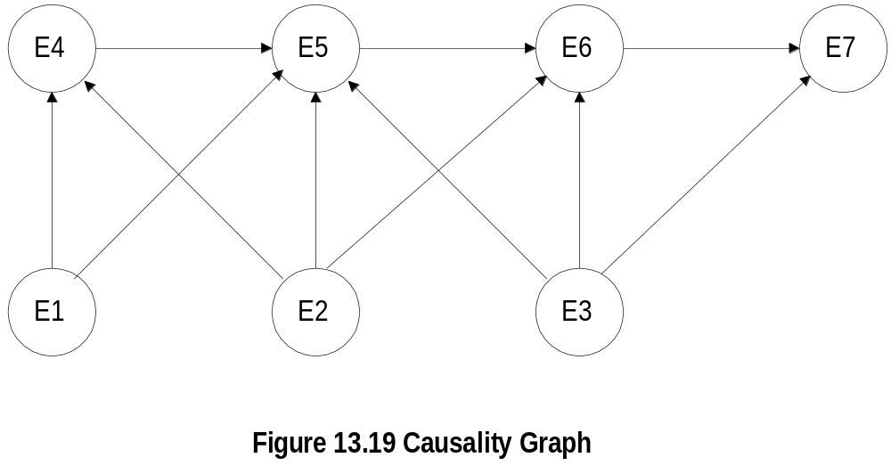
Causality Graph
  Notes
Each node is an event
An event may cause other events
Directed edges start at a causing event and
terminate at a resulting event
Picture causing events as problems and
resulting events as symptoms

Slide 31
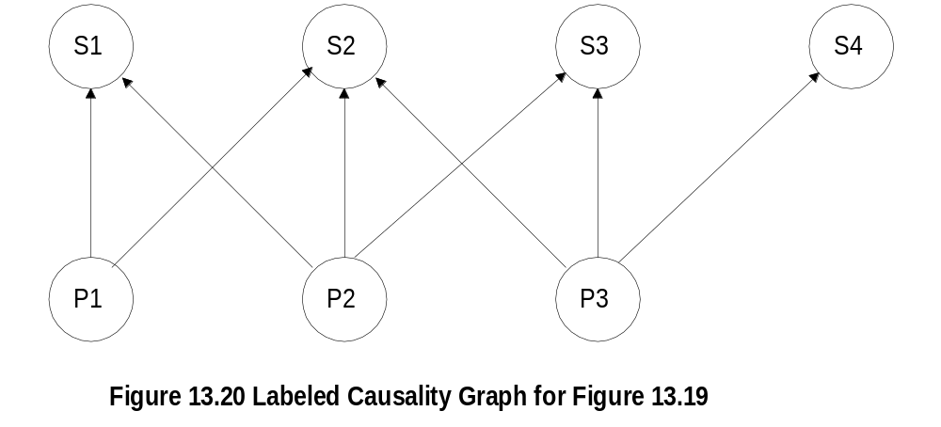
Labeled Causality Graph
  Notes
Ps are problems and Ss are symptoms
P1 causes S1 and S2
Note directed edge from S1 to S2 removed;
S2 is caused directly or indirectly (via S1) by P1
S2 could also be caused by either P2 or P3

Slide 32

Codebook
  Notes
Codebook is problem-symptom matrix
It is derived from causality graph after removing
directed edges of propagation of symptoms
Number of symptoms => number of problems
2 rows are adequate to identify uniquely 3 problems

Slide 33

Correlation Matrix
  Notes
Correlation matrix is reduced codebook

Slide 34
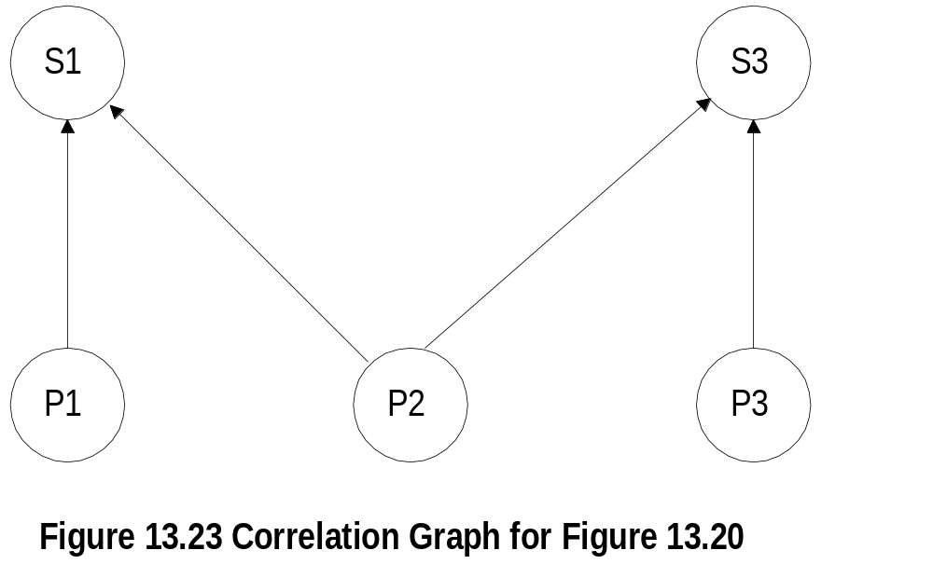
Correlation Graph
  Notes
Correlation graph is derived from correlation matrix

Slide 35
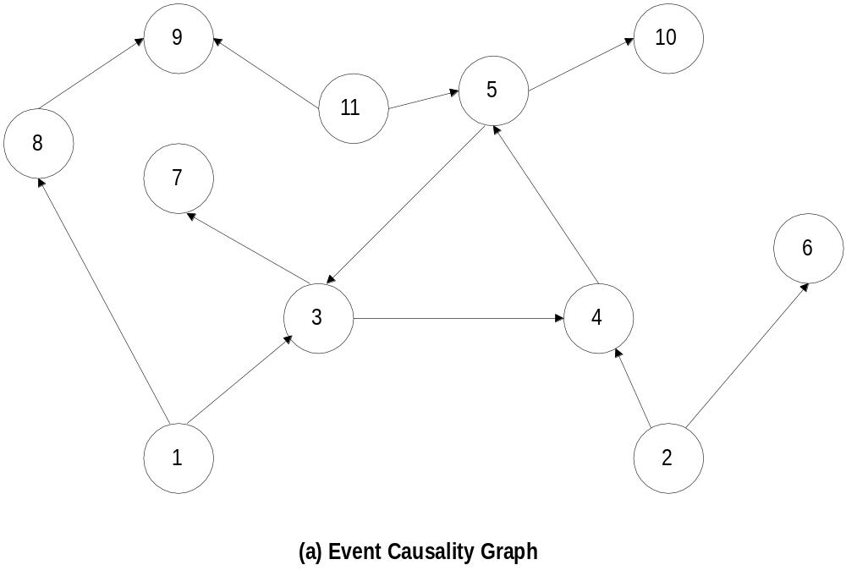
Chapter 13
Generalized Causality Graph
  Notes
Causality graph has 11 events - problems and
symptoms
Mark all nodes that have only emerging directed
edges as problems - Nodes 1, 2, and 11
Other nodes are symptoms
Network Management: Principles and Practice
© Mani Subramanian 2000
13-35

Slide 36
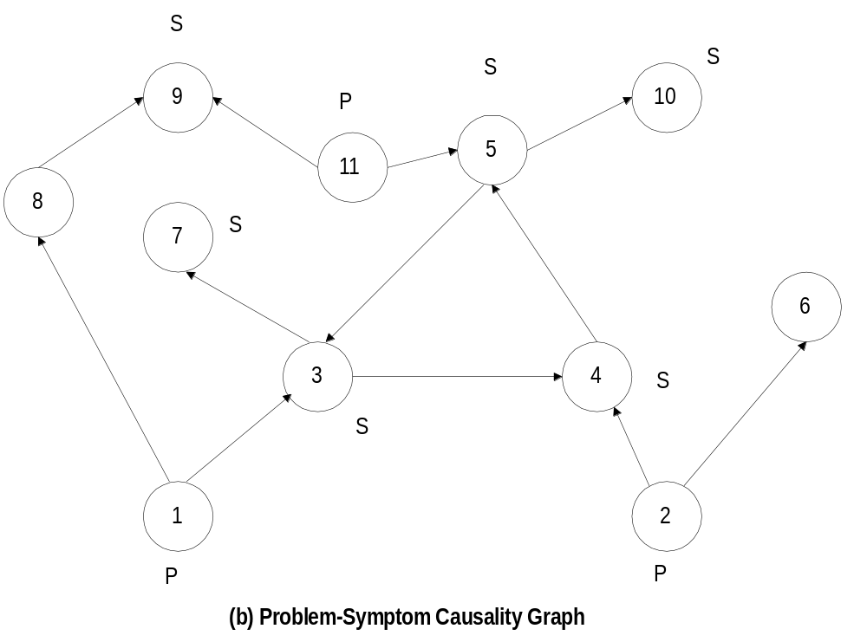
Chapter 13
P-S Causality Graph
  Notes
To reduce causality graph to correlation graph:
  Symptoms 3, 4, and 5 are cyclical: replace with
  one symptom, say 3
  S7 and S10 are caused by S3 and S5 and
  hence ignored
  S8 causes S9. Keep S9 and eliminate S8; reason
  for this would be more obvious if we go through
  reduction of codebook to correlation matrix
13-36

Slide 37
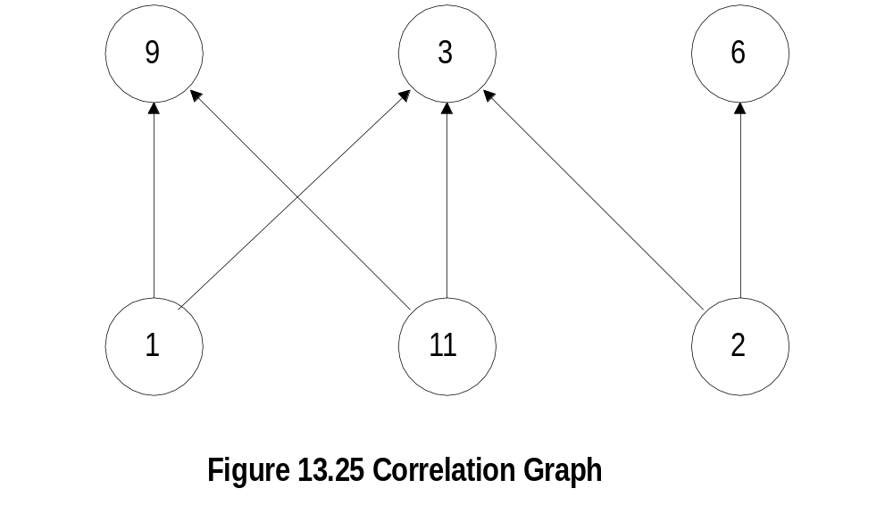

Correlation Graph and Matrix
  Notes
Correlation Matrix
Note that problems 1 and 11 produce identical
symptoms

Slide 38
Codebook Enhancements
Codebook described so far assumes Hamming
distance of 1 for uniqueness
Noise affects accuracy
Increase Hamming distance to >1
Probability of a problem causing a symptom
assumed as 1. It can be made Si = Pr(Pj) to
be more realistic
  Notes

Slide 39
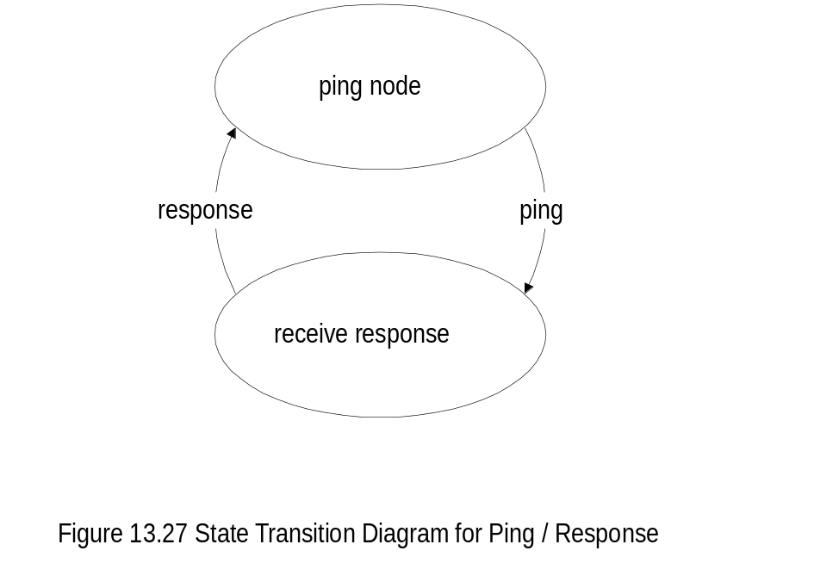
State Transition Model
  Notes
Used in Seagate’s NerveCenter correlation system
Integrated in NMS, such as OpenView
Used to determine the status of a node

Slide 40
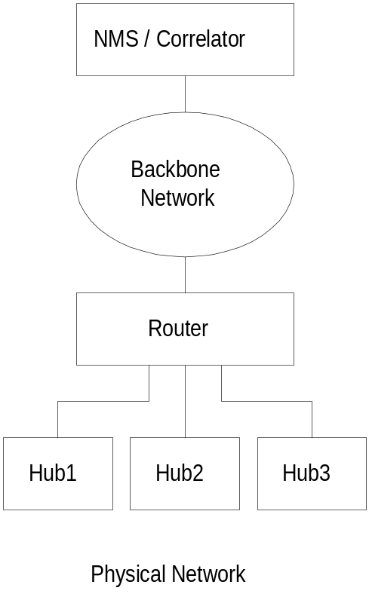
State Transition Model Example
  Notes
NMS pings hubs every minute
Failure indicated by the absence of a response

Slide 41
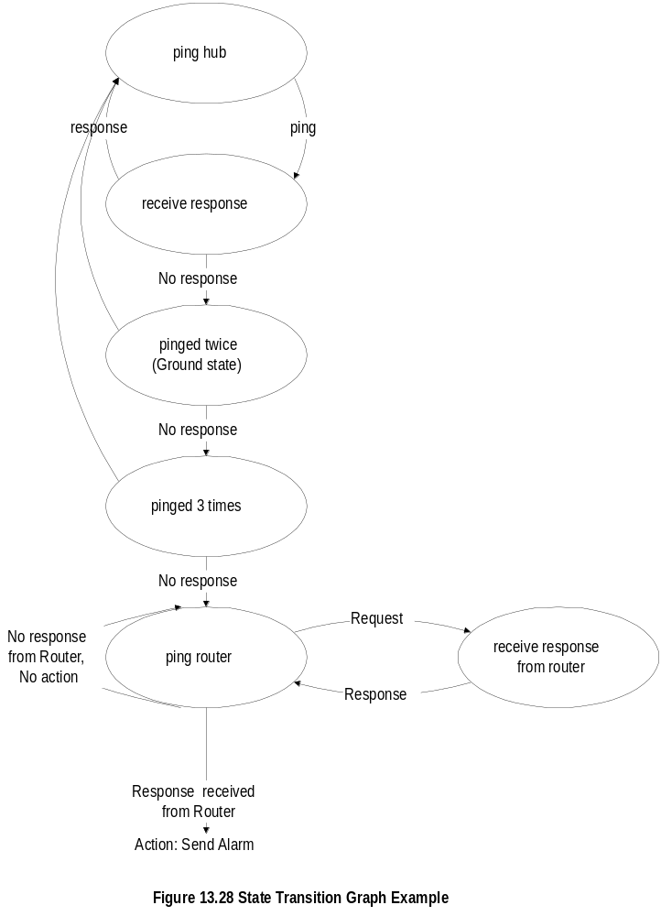
State Transition Graph

Slide 42
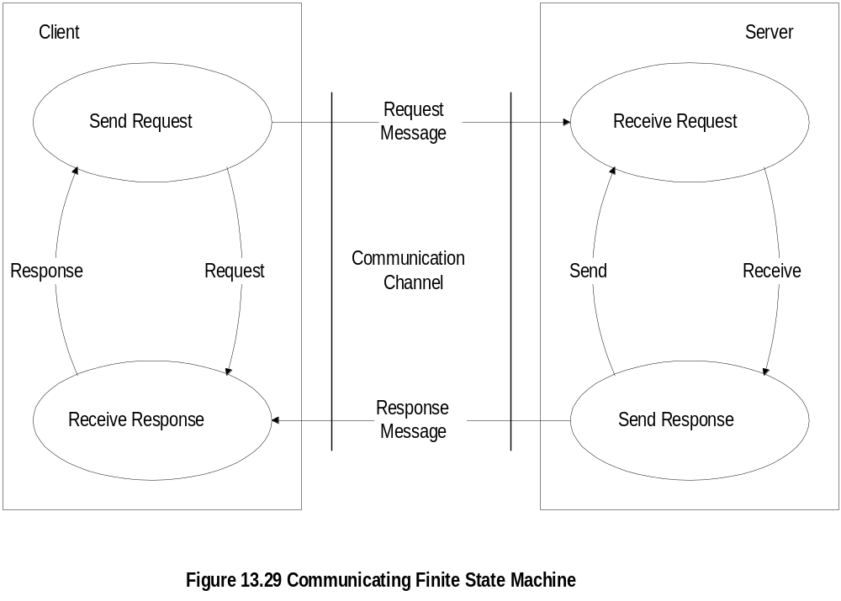
Finite State Machine Model
  Notes
Finite state machine model is a passive system;
state transition graph model is an active system
An observer agent is present in each node and
reports abnormalities, such as a Web agent
A central system correlates events reported by
the agents
Failure is detected by a node entering an illegal
state

Slide 43
Security Management
Security threats
Policies and Procedures
Resources to prevent security breaches
Firewalls
Cryptography
Authentication and Authorization
Client/Server authentication system
Message transfer security
Network protection security
  Notes

Slide 44
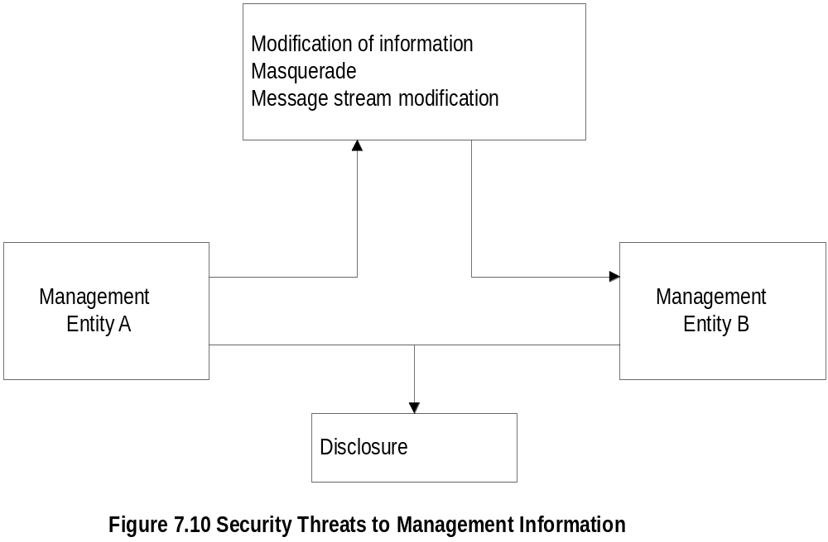
Security Threats
  Notes
SNMPv3 addressed security threats using USM
(user-based security model)
USM has two modules:
  Authentication module
    Data integrity
    Data origin
  Privacy module
    Data confidentiality
    Message timeliness
    Message protection

Slide 45
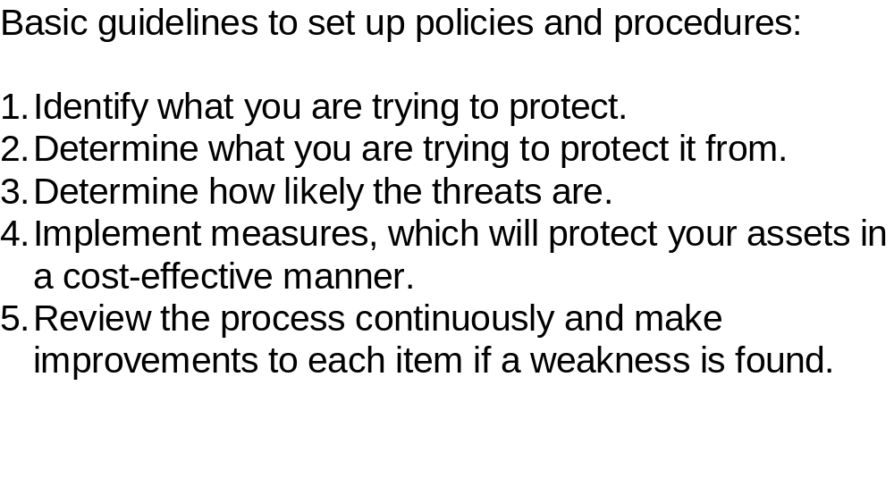
Policies and Procedures
  Notes
References:
  Formal statement of rules for protecting
  organization’s technology and assets (RFC
  2196)
  Introduction to Firewalls (NIST)
  Orange Book by National Computer Security
  Center (NCSC) rates computers based on
  security design features

Slide 46
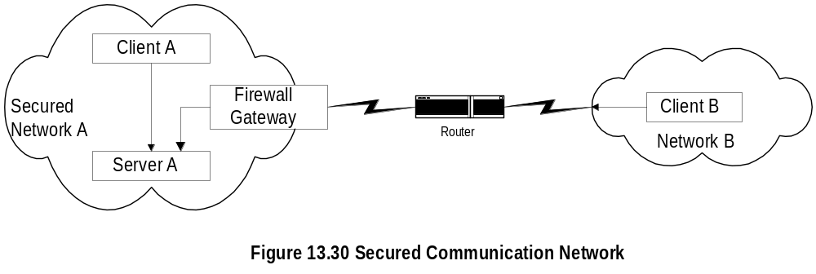
Secured Communication Network
  Notes
Firewall secures traffic in and out of Network A
Security breach could occur by intercepting the
message going from B to A, even if B has
permission to access Network A
Most systems implement authentication with user
id and password
Authorization is by establishment of accounts

Slide 47
Firewalls
Protects a network from external attacks
Controls traffic in and out of a secure network
Could be implemented in a router, gateway, or
a special host
Benefits
  Reduces risks of access to hosts
  Controlled access
  Eliminates annoyance to the users
  Protects privacy (e.g. finger)
  Hierarchical implementation of policy and
  and technology (e.g. finger)
  Notes

Slide 48
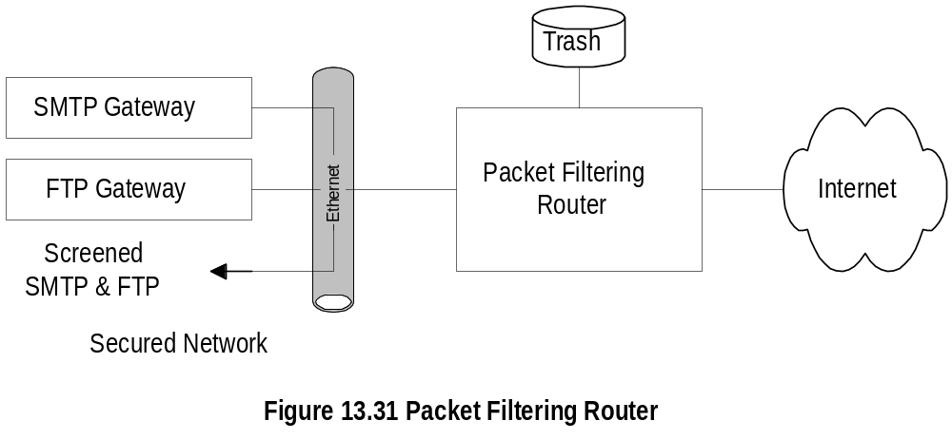
Packet Filtering Firewall
  Notes
Uses protocol specific criteria at DLC, network,
and transport layers
Implemented in routers - called screening router
or packet filtering routers
Filtering parameters:
  Source and/or destination IP address
  Source and/or destination TCP/UDP port
  address, such as ftp port 21
Multistage screening - address and protocol
Works best when rules are simple

Slide 49
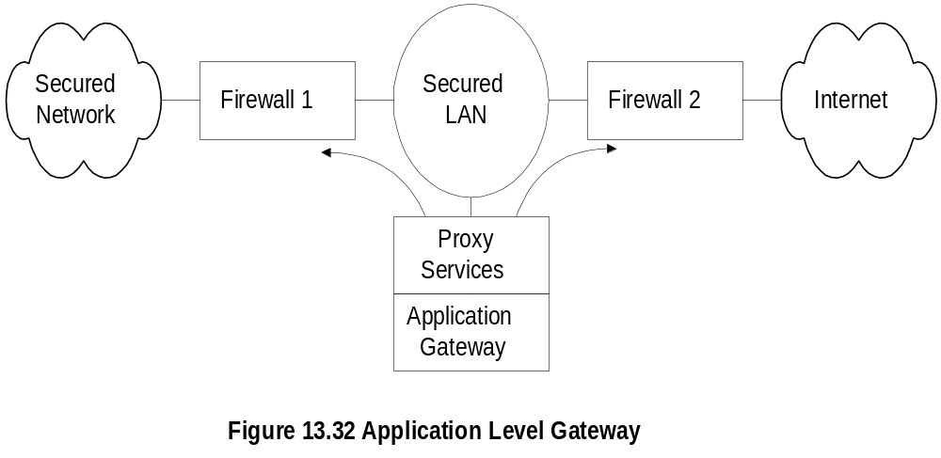
Application Level Gateway
  Notes
Firewalls 1 and 2 route traffic only from and to
the secured LAN
Secured LAN is gateway LAN
Behavior of application gateway dependent on
the application
FTP traffic stored and forwarded after validation
TELNET hosts validated for the session and then
direct communication established

Slide 50
Cryptography
Secure communication requires
  Integrity protection: ensuring that the message
  is not tampered with
  Authentication validation: ensures the originator
  identification
Security threats
  Modification of information
  Masquerade
  Message stream modification
  Disclosure
Hardware and software solutions
Most secure communication is software based
  Notes

Slide 51
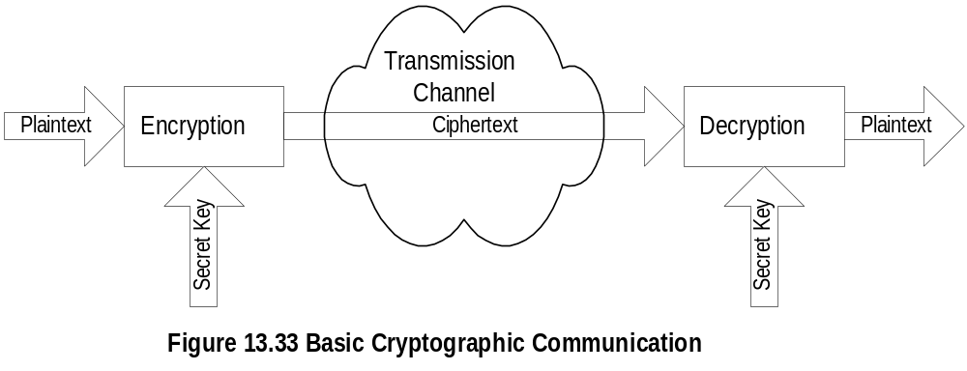
Secret Key Cryptography
  Notes
Caesar cipher: each letter replaced by another
letter, which is three letters behind in the alphabet
Maximum of 26 attempts to decode Caesar cipher
Monoalphabetic cipher: Replace a letter with another
randomly chosen; Maximum attempts to decode 26!
One secret key is needed between each pair
Two standard algorithms for secret key:
  DES (Data Encryption Standard):
  64-bit message blocks and 56-bit key
  IDEA (International Data Encryption Algorithm):
  64-bit message blocks and 128-bit key
Message block derived using CBC (Cipher Block Chaining)
Principle based on rearranging the blocks several
times based on predetermined algorithm and secret key

Slide 52
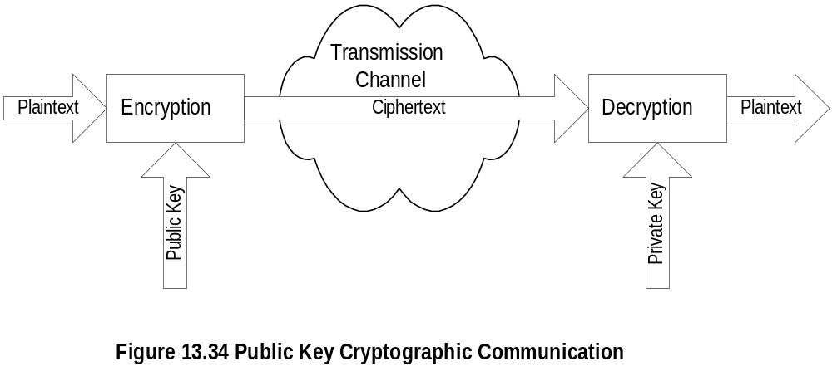
Public Key Cryptography
  Notes
Asymmetric cryptography - public and private key
Public key is distributed by the receiver to the
senders to encrypt the message.
Private key is used by receiver to decode
ciphertext
Mailbox analogy
Commonly used public key is RSA (Rivest, Shamir,
and Adleman); 512-bit key, variable block size
RSA less efficient than DES and IDEA; used to
encrypt secret key

Slide 53
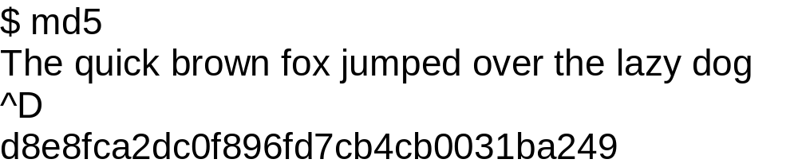
Message Digest
Message digest is a cryptographic hash algorithm
added to a message
One-way function
Analogy with CRC
If the message is tampered with the message
digest at the receiving end fails to validate
MD5 (used in SNMPv3) commonly used MD
MD5 takes a message of arbitrary length (32-Byte)
blocks and generates 128-bit message digest
SHS (Secured Hash Standard) message digest
proposed by NIST handles 2⁶⁴ bits and generates
160-bit output
  Notes
Example:

Slide 54
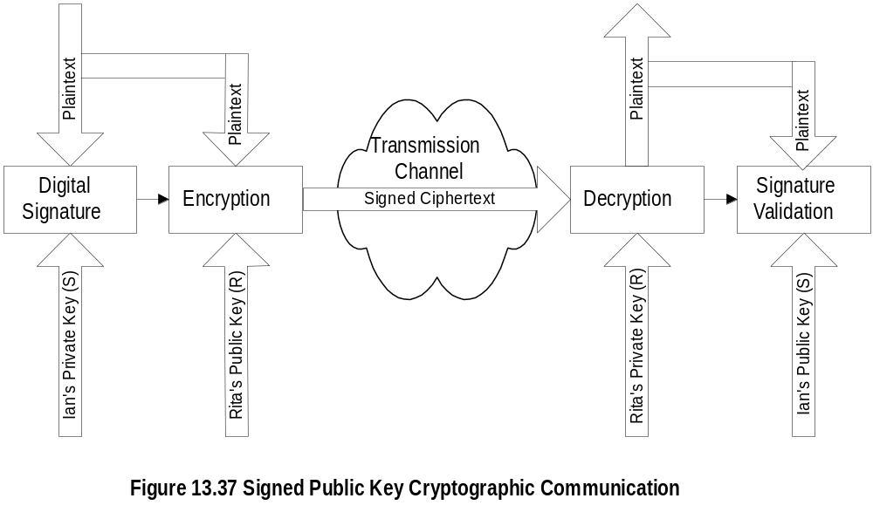
Digital Signature
  Notes
Why do we need digital signature?
Principle reverse of public key
Signature created using private key and validated
using public key
Digital signature is a message digest generated from
plaintext and private key by a hashing algorithm
Digital signature is concatenated with the plaintext
and encrypted using public key

Slide 55
Authentication and Authorization
Authentication verifies user identification
  Client/server environment
    Ticket-granting system
    Authentication server system
    Cryptographic authentication
  Messaging environment
    e-mail
    e-commerce
Authorization grants access to information
  Read, read-write, no-access
  Indefinite period, finite period, one-time use
  Notes

Slide 56
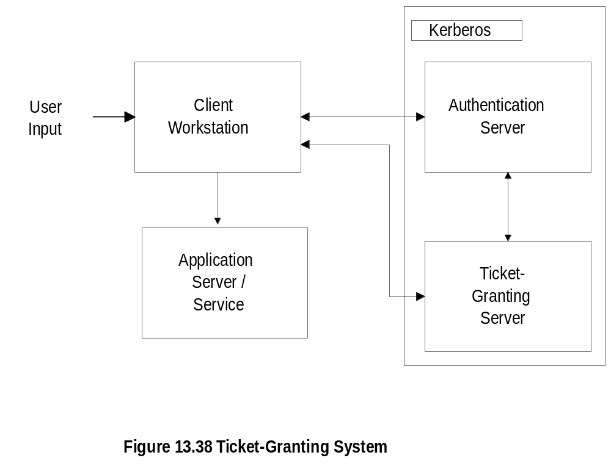
Ticket-Granting System
  Notes
Used in client/server authentication system
Kerberos developed by MIT
Steps:
  User logs on to client workstation
  Login request sent to authentication server
  AS checks ACL, grants encrypted ticket to client
  Client obtains from TGS service-granting ticket
  and session key
  Appl. Server validates ticket and session key,
  and then provides service
13-56

Slide 57
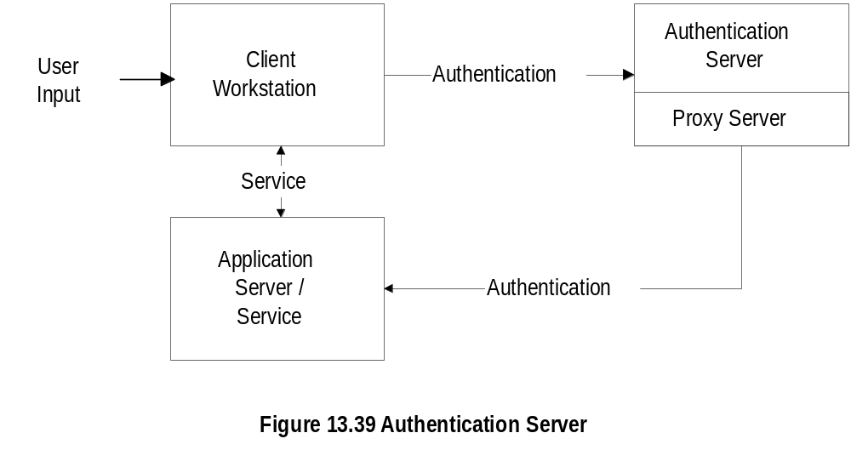
Authentication Server
  Notes
Architecture of Novell LAN
Authentication server does not issue ticket
Login and password not sent from client workstation
User sends id to central authentication server
Authentication server acts as proxy agent to the client
and authenticates the user with the application server
Process transparent to the user

Slide 58
Message Transfer Security
Messaging one-way communication
Secure message needs to be authenticated
and secured
Three secure mail systems
  Privacy Enhanced Mail (PEM)
  Pretty Good Privacy (PGP)
  X-400: OSI specifications that define
  framework; not implementation specific
  Notes

Slide 59
Privacy Enhanced Mail
Developed by IETF (RFC 1421 - 1424)
End-to-end cryptography
Provides
  Confidentiality
  Authentication
  Message integrity assurance
  Nonrepudiation of origin
Data encryption key (DEK) could be secret or
public key-based originator and receiver
agreed upon method
PEM processes based on cryptography and
message encoding
  MIC-CLEAR (Message Integrity Code-CLEAR)
  MIC-ONLY
  ENCRYPTED
  Notes

Slide 60
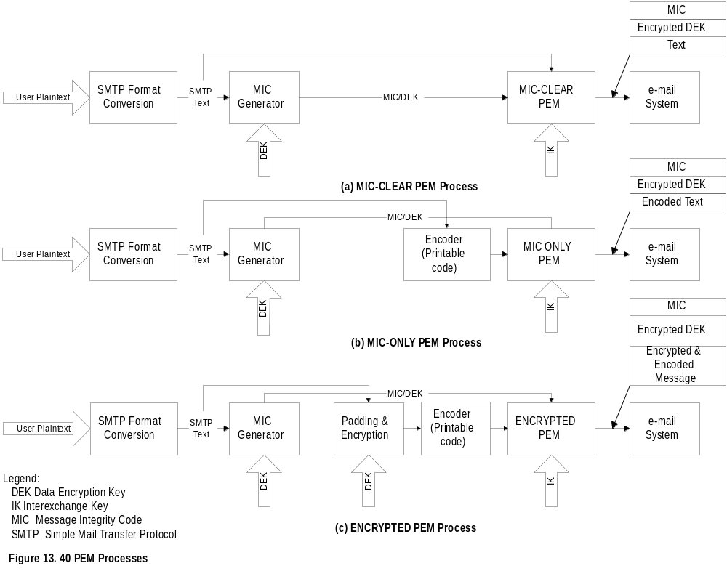
PEM Processes
(Originating end)
  Notes
DEK a random number generated per message basis:
used to encrypt the message text and generate MIC
IK a long-range key agreed upon between the sender
receiver used to encrypt DEK: IK is either public or
secret
Public key avoids repudiation

Slide 61
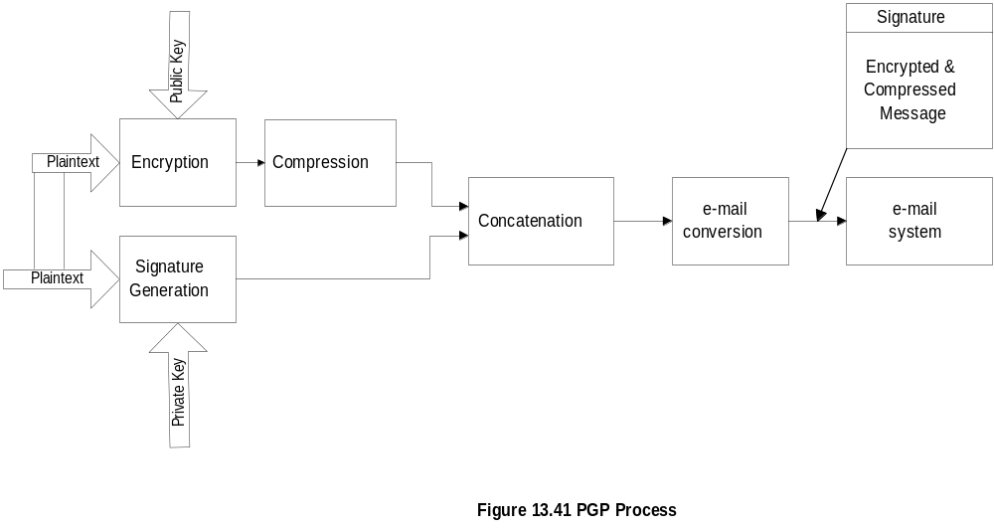
Pretty Good Privacy
(Originating end)
  Notes
PGP secure mail package developed by Zimmerman
Available in public domain
Signature generation
  Uses MD5 to generate hash code
  Encrypts hash code with sender’s private key
  using RSA algorithm
Encryption of the message done using IDEA or RSA
Compression done with ZIP
e-mail conversion done using Radix-64
PGP similar to encrypted PEM with added
compression

Slide 62
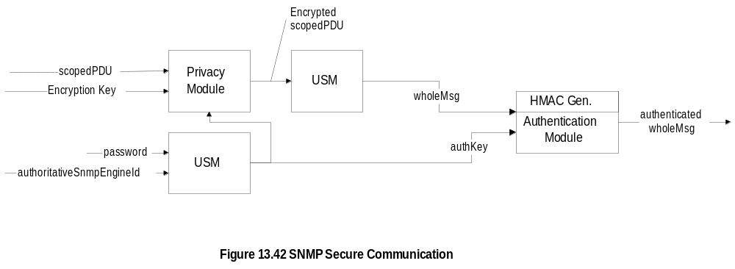
SNMPv3 Security
(Outgoing message)
  Notes
Authentication key equivalent to DEK in PEM or
private key in PGP
Authentication key generated using user password
and SNMP engine id
Authentication key may be used to encrypt message
USM prepares the whole message including
scoped PDU
HMAC, equivalent of signature in PEM and PGP,
generated using authentication key and the whole
message
Authentication module provided with authentication
key and HMAC to process incoming message

Slide 63
Virus Attacks
Executable programs that make copies and
insert them into other programs
Attacks hosts and routers
Attack infects boot track, compromises cpu,
floods network traffic, etc.
Prevention is by identifying the pattern of the
virus and implementing protection in virus
checkers
  Notes

Slide 64
Accounting Management
Least developed
Usage of resources
Hidden cost of IT usage (libraries)
Functional accounting
Business application
  Notes

Slide 65
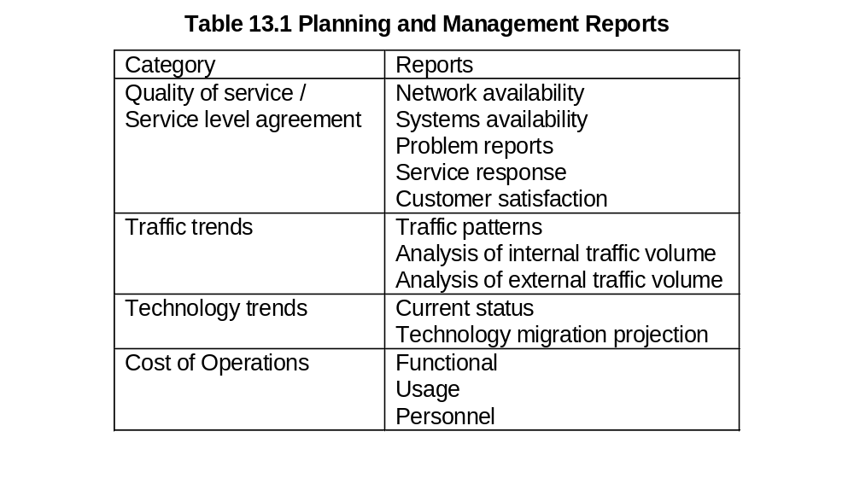
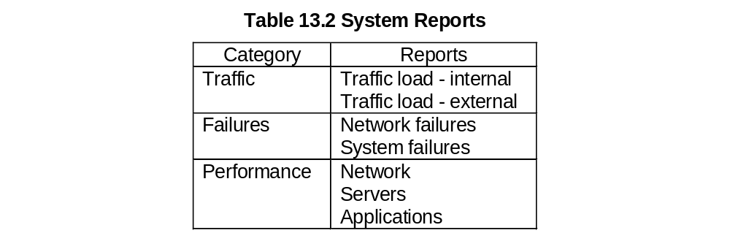
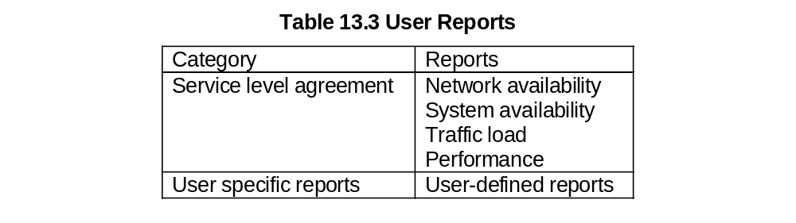
Report Management

Slide 66
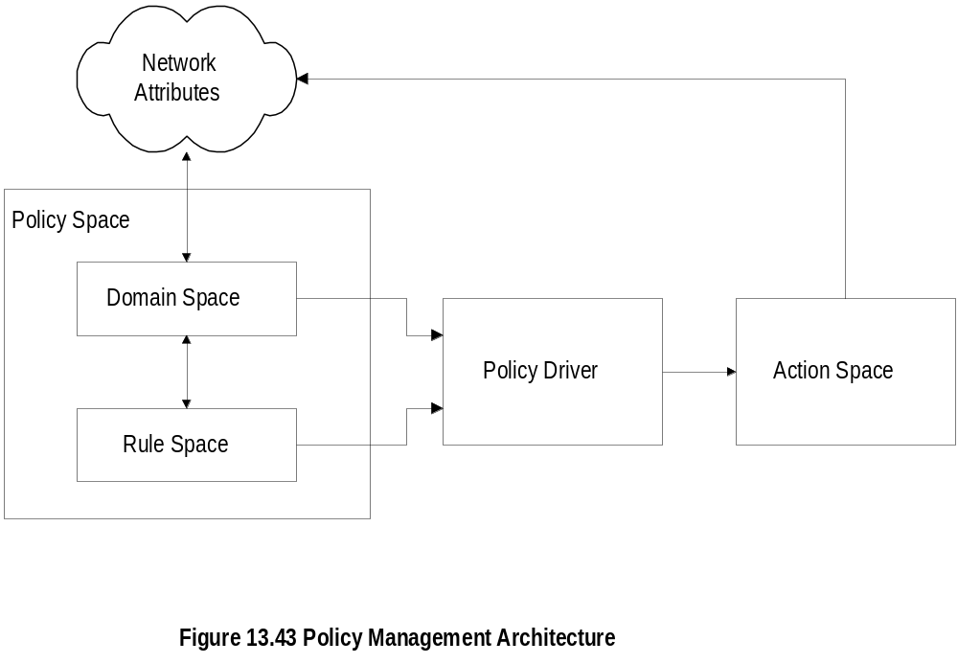
Policy-Based Management
  Notes
Domain space consists of objects (alarms with
attributes)
Rule space consists of rules (if-then)
Policy Driver controls action to be taken
Distinction between policy and rule; policy assigns
responsibility and accountability
Action Space implements actions

Slide 67
Service Level Management
SLA management of service equivalent to
QoS of network
SLA defines
  Identification of services and characteristics
  Negotiation of SLA
  Deployment of agents to monitor and control
  Generation of reports
SLA characteristics
  Service parameters
  Service levels
  Component parameters
  Component-to-service mappings
  Notes

